Slide 1
NEPs: The Federal Perspective
The Law: The Clean Water Act (amended, 1987)
The National Estuary Program was created by the U.S. Congress in 1987 through amendments to the Clean Water Act, with the goal to "identify, restore, and protect nationally significant estuaries in the United States."
Notes:
To restore and maintain
the chemical and biological integrity of the Nation’s Waters
so that they can support
the protection and propagation of
fish, shellfish, wildlife and recreation in and on the water…
The original goal of the Clean Water Act was to eliminate the discharge of untreated waste water from municipal and industrial sources and thus make American waterways safe for swimming and fishing.
When reading the historical discussions leading up to enactment of the CWA, it is clear that this act established a principle that when somebody uses water, it should be returned at least in the same or better condition, hence the ultimate goal of the Act: To eliminate all water pollution by 1985. Read more: http://www.answers.com/topic/clean-water-act#ixzz1FpqNMjt3
Public Health Service Act of 1912. Expanded the mission of the United States Public Health Service to study problems of sanitation, sewage and pollution.^{[46]}
Oil Pollution Act of 1924. Prohibited the intentional discharge of fuel oil into coastal waters.^{[47]} Repealed by 1972 CWA.
Federal Water Pollution Control Act of 1948. Created a comprehensive set of water quality programs that also provided some financing for state and local governments. Enforcement was limited to interstate waters. The Public Health Service provided financial and technical assistance.^{[48]}
Water Quality Act of 1965. Required states to issue water quality standards for interstate waters, and authorized the newly created Federal Water Pollution Control Administration to set standards where states failed to do so.^{[49]}

Slide 2
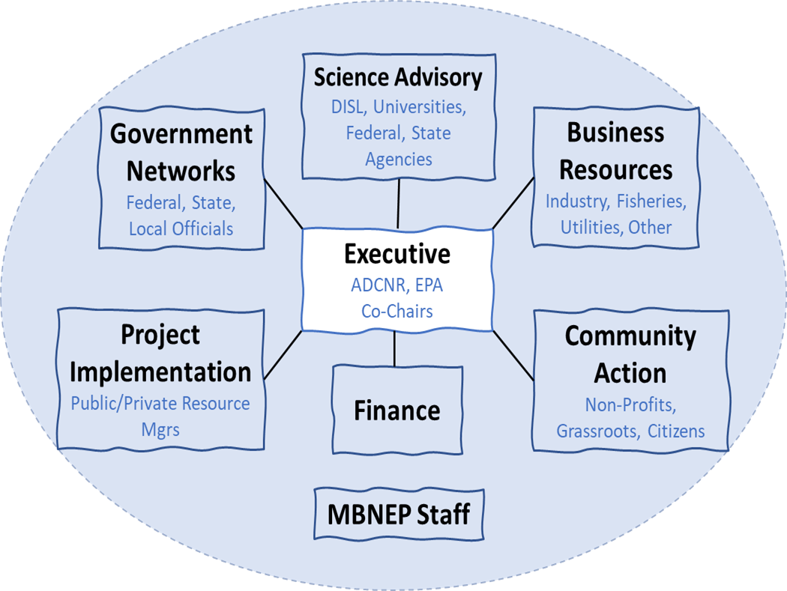
Section 320 of the Clean Water Act: NEPS will
Champion protection and restoration efforts through cultivation of partnerships
Lead watershed protection by coordinating collective actions to measurably improve water quality, habitat management and living resource management
Establish a community of committed environmental stewards
Assess trends
Identify causes
Develop relationships
Develop collective plan
Coordinate collective implementation
Monitor effectiveness
Provide consistency reviews

Slide 3
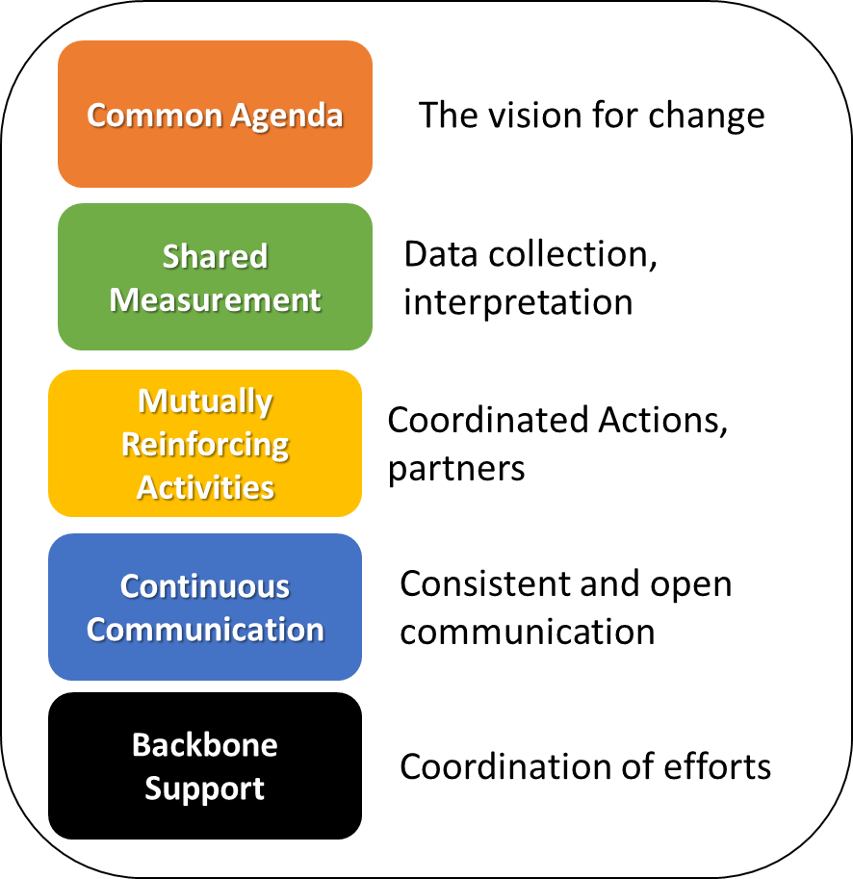
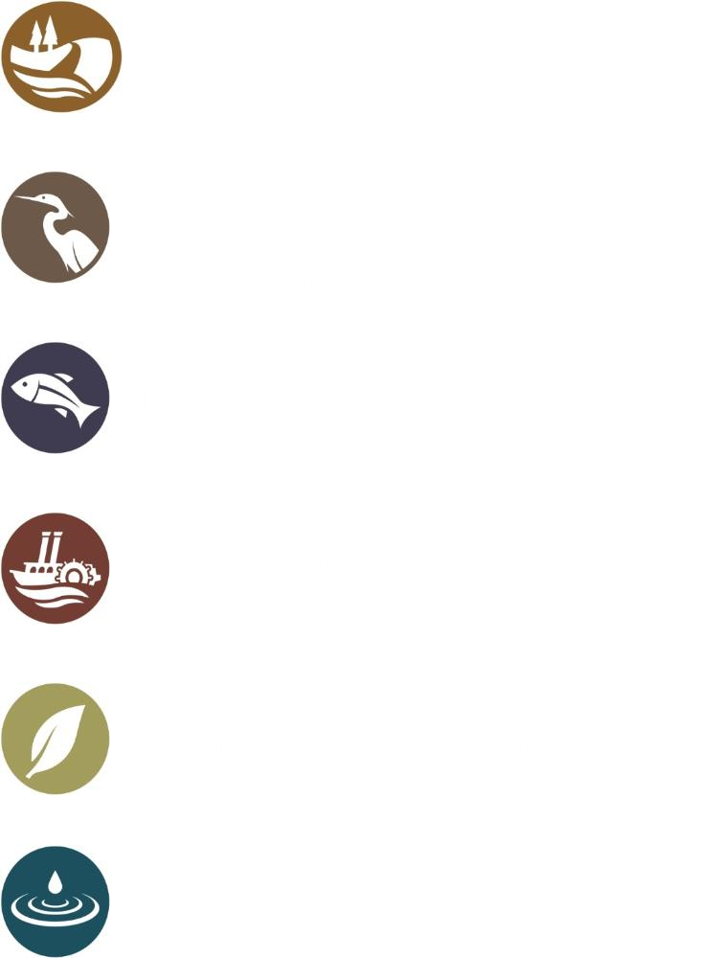
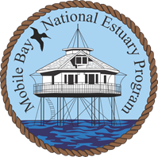
MBNEP: How we achieve Collective Impact, Why?
The CCMP
A Monitoring Strategy
Shovels in the ground
Mgt Conference Committees
MBNEP
MBNEP
Notes:
We work to achieve collective impact by creating a common agenda, collecting data on a regular basis and then synthesizing it to improve management efforts, coordinating and collaborating on restoration projects, communicating actions through committee meetings, networking at conferences like this, and through social media, and providing an organization who acts as the backbone support, the MBNEP.
We are collectively focused on protecting six things people value most about living on the Alabama coast.
Access to the water and open spaces
Sustainable beaches and shorelines
Robust populations of fish and wildlife
Conservation of our community’s heritage and cultures
Environmental and community resilience
Continuous improvement of water quality for fishing and swimming

Slide 4
MBNEP: A Unique Among Environmental Organizations
MBNEP IS NOT:
An activist organization
An individual organization setting its own environmental priorities at the risk of others or our environment
Funded by membership and donors
Led by a single director with a Board of Directors
Focused on the short-term environmental controversy of the day
MBNEP IS:
Science-based
A partnership organization, lifting, promoting and complementing the work of our partner organizations
Funded by US EPA, State of Alabama, Local Counties and Municipalities
A multi-sector “conference” of leaders
Guided by a Management Conference created Comprehensive Conservation and Management Plan

Slide 5
An MBNEP Timeline…
1995 MBNEP Created
2006 Current Management Conference Structure The SAC Created
2002 First CCMP Published
1995
2002
2006

Slide 6
2011 The Stressor Matrix Employed
2009 Biological Gradient Condition Introduced
2008 State of the Bay Published
Most Stressed Habitats
Freshwater wetlands
Streams, Rivers, Riparian buffers
Intertidal Marshes and Flats
1995
2002
2006
2008
2009
2011

Slide 7
2013 Second CCMP Published
2016 State of Bay revisited: Could we develop Indices?
2015 Monitoring Framework Published/
Employed in D’Olive as test
The EST strategy: How do we use the BCG to communicate the State of the Bay?
1995
2002
2006
2008
2009
2011
2013
2015
2016

Slide 8
2017
Fowl River Marsh Health Study Begins (Funder Request); Bylaws changed
2020 BCG to WCI- The D’Olive Watershed Test; Back to Stressor Matrix
2018-19 Second CCMP Update published; New Co-Chairs; GNC Coal Ash Request
NEPs reauthorized: Required to do either an update or re-write every five years…
1995
2002
2006
2008
2009
2011
2013
2015
2016
2017
2018
2020

Slide 9
2020
The Decadal Study underway
2022 Stressor Matrix, Determining Data Gaps; Begin discussions about updating the Monitoring Framework
2021 Revisiting the State of the Bay, Stressor Matrix, Modeling outputs of Decadal Study
With update underway, NEP begins planning for next CCMP (will it be an update or re-write)?
The Decadal study becomes a key element of the next CCMP.
1995
2002
2006
2008
2009
2011
2013
2015
2016
2017
2018
2020
2021
2022

Slide 10
2023
Building a foundation for Third CCMP: Stressor Matrix Finalization; Synthesis of Watershed Plans; CCMP Evaluation; Bylaws update
2025 Third CCMP to be published.
2024 Next State of the Bay; Synthesis of all we know to inform EST Strategy
In consultation with EPA, the amount of data generated, the number of watershed plans completed, and the opportunity to address both local and system-wide challenges through the decadal study trigger a CCMP rewrite.
1995
2002
2006
2008
2009
2011
2013
2015
2016
2017
2018
2020
2021
2022
2023
2024
2025

Slide 11
The Road Ahead
Year | Target Date | Activity
2023 | March/April 31 | Watershed Assessment
 | May 31 | CCMP Evaluation
 | June 30 | Stressor Evaluation Technical Report
 | December 31 | Community Outreach Phase One
2024 | January 31 | MC Organizational Structure Assessment
 | March 31 | State of Alabama's Estuaries and Coast
 | December 31 | Outreach Phase Two
2025 | June 30 | CCMP Re-Write: Strategy Development
 | August 31 | CCMP Out for Public Comment
 | September 30 | CCMP Finalization and Approvals
 | October 1 | Begin Implementation

